Slide 1
mCLASS Demystified
Rhonda Grode
Literacy Coach
*using information from mclasshome.com/homeconnect

Slide 2
So, what is mCLASS?
mCLASS is a universal screener that measures the development of reading skills of all students in grades K-5 through two main assessments:
DIBELS
TRC

Slide 3
DIBELS
Dynamic Indicators of Basic
Early Literacy Skills

Slide 4
Literacy Skills
Phonological Awareness
Phonics
Accurate and Fluent Reading

Slide 5
Phonological Awareness
Before being able to read letters and words, students need to be able to hear the individual sounds in words.
Example: “cat” is /c/ /a/ /t/
Assessments:
FSF (First Sound Fluency)
PSF (Phoneme Segmentation Fluency)

Slide 6
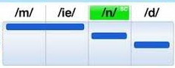
Phoneme Segmentation Fluency

Slide 7
Phonics
Students must understand that letters and letter patterns represent sounds of spoken language that are blended together to make words.
Components:
Letter-sound correspondence
Blending
Letter-sound patterns and word part
Students must learn to accurately and fluently decode so that they can focus on comprehension.

Slide 8
Phonics Assessments
NWF
Nonsense Word Fluency

Slide 9
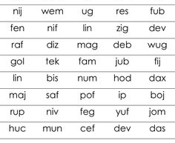
NWF Assessment

Slide 10
Accurate and Fluent Reading
Fluency: read a text accurately, automatically, and with expression
Fluency readers do not have to concentrate on sounding out words.
Fluent readers can focus on what the text means.
Assessment: DORF
DIBELS Oral Reading Fluency

Slide 11
DORF Assessment
Standardized Passages
Retell
Assesses accuracy, fluency, and simple retell

Slide 12
DAZE Assessment
Students are asked to silently read a passage with some missing words and choose the correct word that makes the most sense in the story.
Taken online
Assesses comprehension

Slide 13
TRC
Text Reading and Comprehension

Slide 14
TRC Assessment
Students read a leveled text and answer oral and written comprehension questions about the text.
Assesses:
Specific accuracy errors
Retell (Levels A-D)
Oral Comprehension
Written Comprehension (F+)

Slide 15
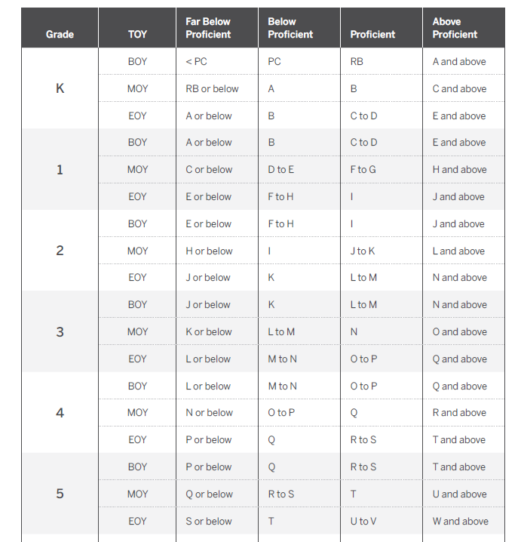
TRC Levels

Slide 16
DIBELS Assessments per Grade Level
 | K | 1 | 2 | 3 | 4 | 5
Letter Naming Fluency (LNF) | All | BOY
First Sound Fluency (FSF) | BOY MOY
Phoneme Segmentation Fluency (PSF) | MOY EOY | BOY
Nonsense Word Fluency (NWF) | MOY EOY | All | BOY
DORF |  | MOY EOY | All | All | All | All
DAZE |  |  |  | All | All | All

Slide 17
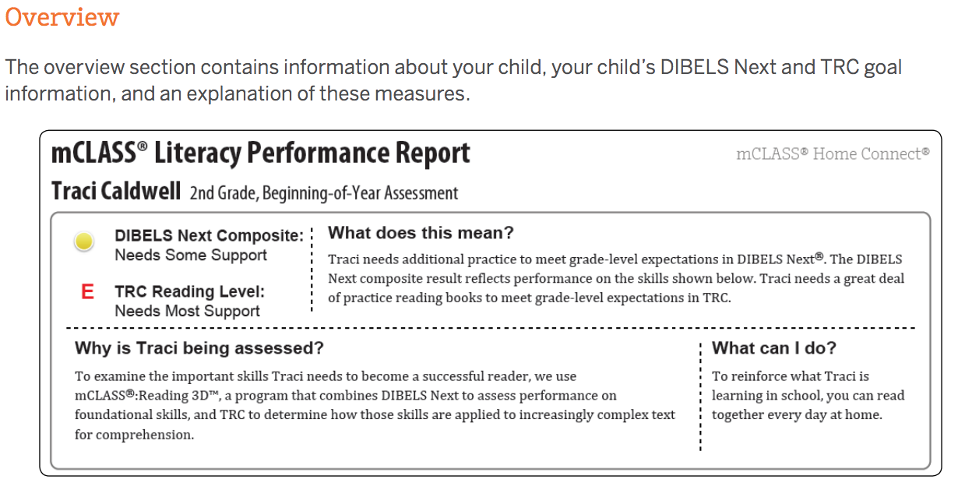
Home Connect

Slide 18
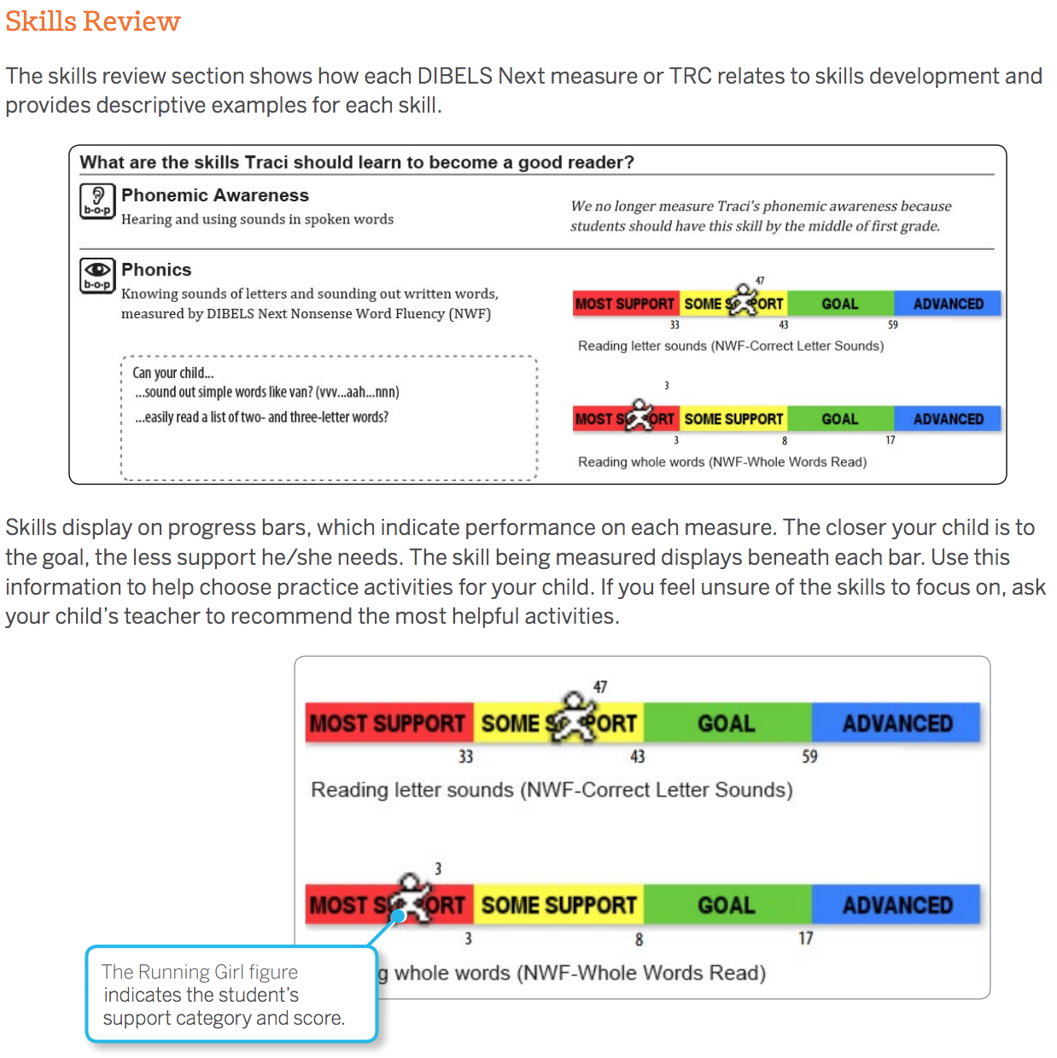
Home Connect

Slide 19
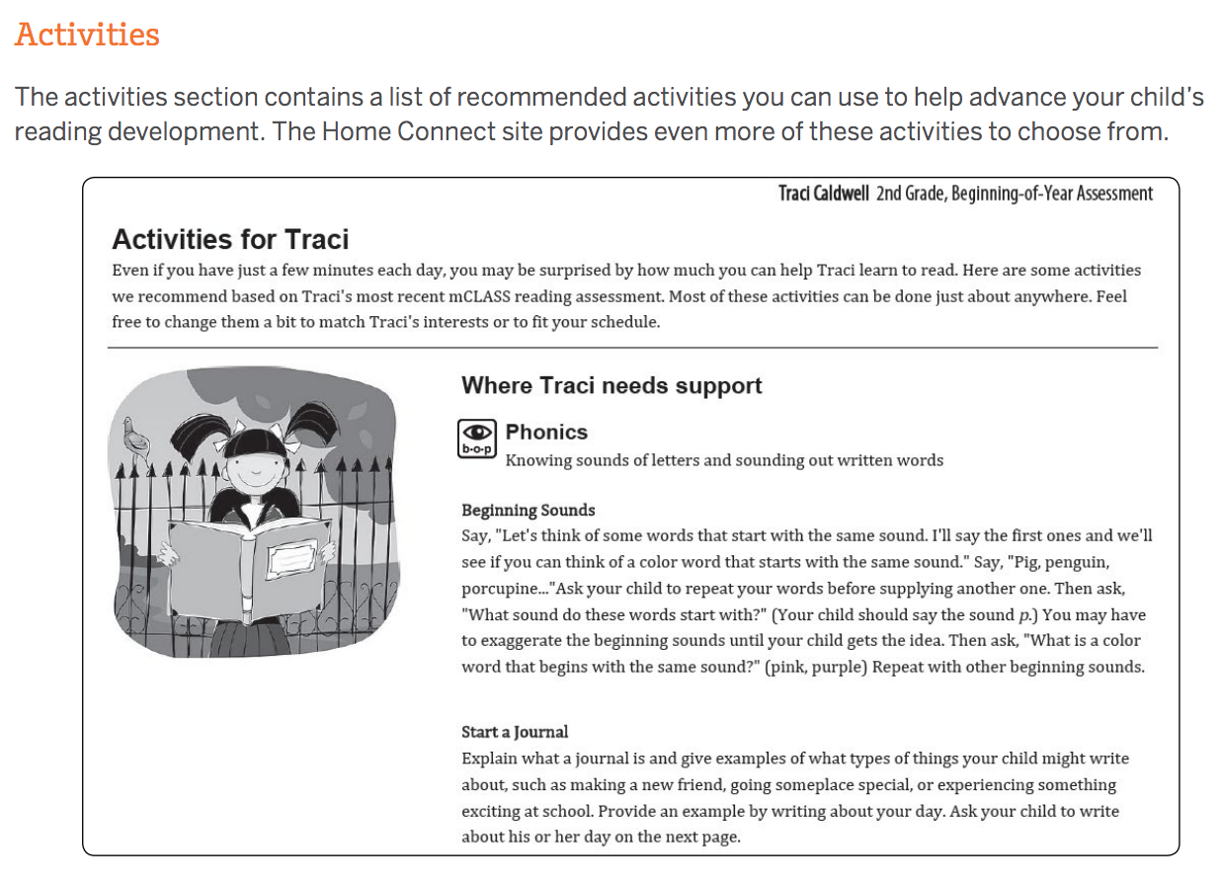
Home Connect

Slide 20
Home Connect - Website
Resources
mclasshome.com/homeconnect
Mrs. Grode’s website

Slide 21
THANKS!
Any questions?
Contact me at rgrode@wcpss.net
(919)773-9555 ext.

